Slide 1
KBEFD
Establishment License Online Renewal

Slide 2
Establishment Renewal Login
Sign in using the license number and the last 4 digits of the registered phone number. If you have trouble on this screen, contact the office

Slide 3
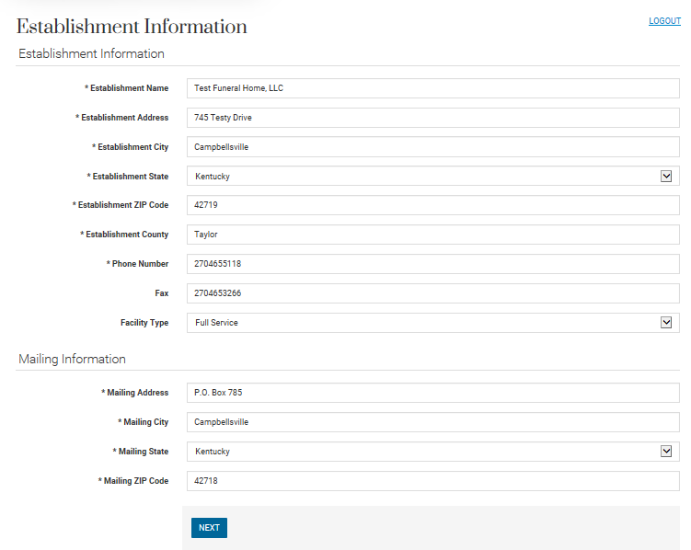
Review Establishment Information
Any changes can be made by clicking in the box and typing or choosing an option.

Slide 4
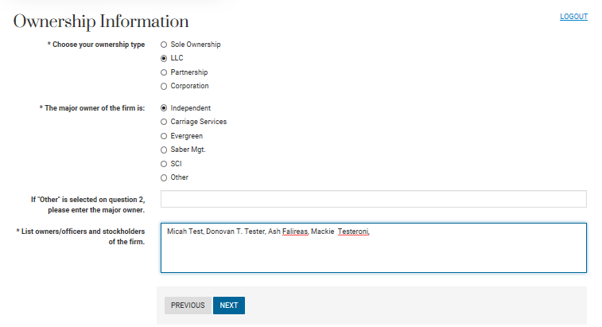
Ownership Information
Input
Choose ownership type; major firm owner, and enter “other” explanation and/or Owner/Officer, and stock holder information.

Slide 5
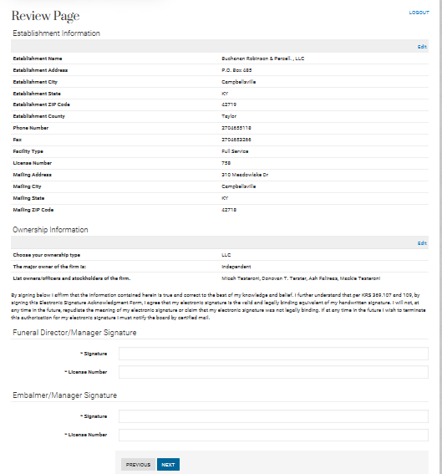
Review & SIgn
Review and use “edit” to make any changes. Read the electronic signature disclosure and, if you agree, affix your electronic signature

Slide 6
Review & Sign
By signing below I affirm that the information contained herein is true and correct to the best of my knowledge and belief. I further understand that per KRS 369.107 and 369.109, by signing the Electronic Signature Acknowledgement Form, I agree that my electronic signature is the valid and legally binding equivalent of my handwritten signature. I will not, at any time in the future, repudiate the meaning of my electronic signature or claim that my electronic signature was not legally binding. If at any time in the future I wish to terminate this authorization for my electronic signature I must notify the board by certified mail.
Review and use “edit” to make any changes. Read the electronic signature disclosure and, if you agree, affix your electronic signature.

Slide 7
Payment
Choose payment type.
At this point, you still have the option to cancel the renewal and restart or complete a paper renewal.

Slide 8
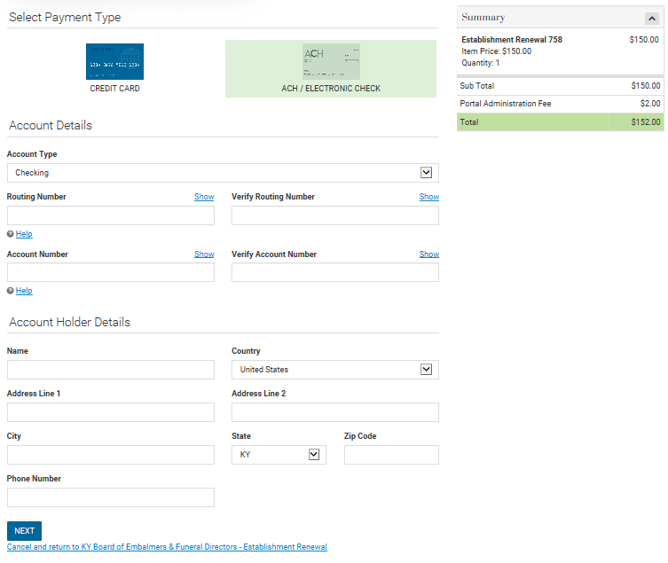
Input Payment information
Credit Card payments are subject to a 2.75% portal fee based upon the TOTAL of the transaction. ACH payments are subject to a $2 flat fee regardless of the total.

Slide 9
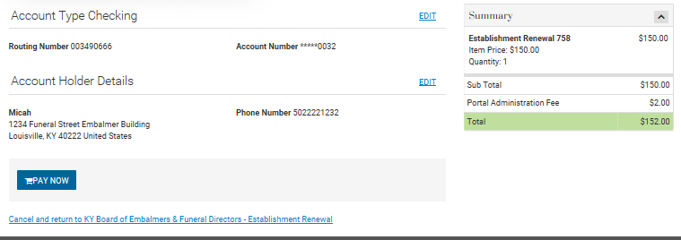
Review Payment
Review payment information. At this point you can still cancel the renewal and start over or complete a paper renewal.

Slide 10
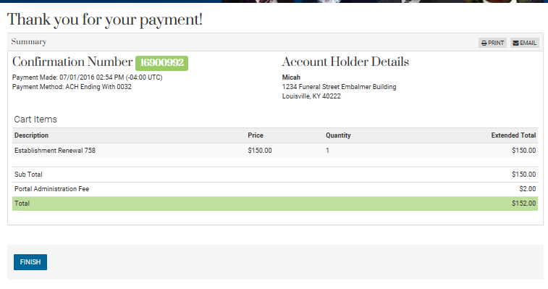
Confirm Payment
Review payment confirmation and print or email this page. Be sure to click “FINISH”.

Slide 11
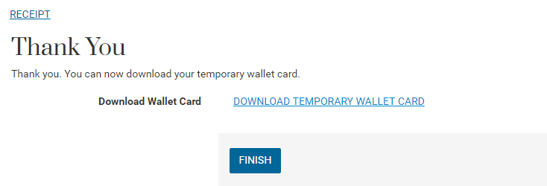
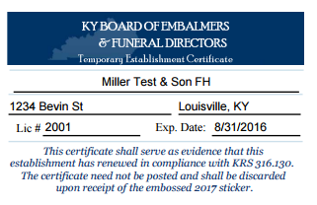
Temporary Certificate
A temporary certificate is available to download and print. It does expire and must be discarded upon receipt of the official sticker from the Board office.

Slide 12
GPL
Send the GPL to the board office via mail or fax.
Be sure to put your license number on the front page of the GPL
Mail: 9114 Leesgate Rd Ste 4 Louisville, KY 40222
Fax: 502-426-4117

Slide 13
Thank you
This concludes the information needed to complete the Online Establishment Renewal; if you have any further questions feel free to contact the office staff.

